Slide 1




Les politiques publiques d’EMI en Europe: forces et faiblesses de la gouvernance
Divina Frau-Meigs, U Sorbonne Nouvelle
Irma Velez, ESPE – U Paris Sorbonne
Julieta Flores, U Autónome de Nuevo León (Mexique)

Slide 2
DEFINITION
Cadre politique et moyens de mise en oeuvre
Rôle des autres acteurs ?
Methodologie:
Approche quali-quanti:
qualitative: 28 rapports
(sur la base d’un document commun)
quantitative: grille de codage
(50 variables/6 dimensions)
28 pays
68 experts (environ 3/pays)
En ligne à: www.translit.fr
Hypothèse :
Notes:
This research attemps to figure out why ùedia education seemed to be stallling despite the ne educational change of paradigm with the increase of digital technologies and despute the EU recommendations to foster MIL evaluation and reporting.
We identified the dimensions scusceptible to generate a problem:
Official texts: policy framework
Cacapicy building (ressources, teacher training, financement) pouvait être défaillant ou pas
Other actors :from the three seconts (public, private, civic).
In Belgrade (sept 2013) the COST network raised the définition as an issue depending on what it is able to embrace it affects policies and applications.

Slide 3
^{grille} ^{de codage (ex: France)}
 |  | 1 | 2 | 3 | 4 |  | 5 | 6 | 7 | 8 | 9 | 10 |  | 11 | 12 | 13 | 14 | 15 | 16 | 17 | 18 | 19 | 20 |  | 21 | 22 | 23 | 24 | 25 | 26 | 27 | 28 |  | 29 | 30 | 31 | 32 | 33 | 34 | 35 | 36 |  | 37 | 38 | 39 | 40 | 41 | 42 | 43 | 44 |  | 45 | 46 | 47 | 48 | 49 | 50
France | DEFINITION | Media education | Information literacy | Computer literacy | Digital literacy L | POLICY FRAMEWORK | Standard setting tools | Media ed authority | Interministerial mechanism | Link with other actors | Co-reg. mechanism | Reporting | TRAINING | Teacher training : initial | : continuous | School level : primary | Junior high | High school | certification | curriculum | Set of competences | Discipline : separate | transversal | RESSOURCES | Teaching materials | Research institutions | Creation by teachers | Creation by editors | Selection by teachers | Selection by editors | Producion from project | From mandatory act. | FUNDING | Central government funding | Provinces/Region funding | Municipalities funding | Private sector | Public sector | Civic sector | Specific allocation | Financial report | OTHER ACTORS | Partnerships outside | Reg. media authorities | Private sector2 | Civil society org | Youth participation | Professional org | Specific events | Overlapping structures | EVALUATION | Media accountability | Efficiency measures | Performance of ressources | Publics targeted | Amount of programmes | Yearly report
L |  | 4 | 4 | 3 | 3 |  | 3 | 4 | 3 | 3 | 0 | 2 |  | 3 | 4 | 2 | 3 | 4 | 2 | 3 | 3 | 1 | 3 |  | 4 | 2 | 2 | 3 | 4 | 2 | 3 | 4 |  | 3 | 4 | 2 | 3 | 2 | 3 | 4 | 2 |  | 4 | 4 | 2 | 3 | 3 | 4 | 4 | 3 |  | 3 | 2 | 3 | 2 | 3 | 0
T |  | 2 | 3 | 3 | 3 |  | 3 | 2 | 3 | 3 | 0 | 3 |  | 2 | 1 | 3 | 2 | 1 | 3 | 3 | 2 | 3 | 3 |  | 2 | 3 | 3 | 2 | 2 | 3 | 2 | 2 |  | 2 | 2 | 3 | 2 | 3 | 2 | 1 | 3 |  | 2 | 3 | 3 | 2 | 2 | 2 | 3 | 3 |  | 2 | 1 | 2 | 3 | 3 | 0
 |  |  | LEVEL |  |  |  |  |  |  | TREND
 |  | 1 | Not present |  |  |  |  |  | 1 | Declining
 |  | 2 | Initial stage |  |  |  |  |  | 2 | Stable
 |  | 3 | Advanced stage |  |  |  |  |  | 3 | Progresing
 |  | 4 | Fully present |  |  |  |  |  | 0 | Not applicable
 |  | 0 | Not applicable
^{TITRE}
Notes:
Here is an example of the scope every country’s experts had to fill, for the geogrpahical maping we used the mode for each dimension

Slide 4
Tendances globales
Niveaux Globaux
0 - 19%: not significant
20 - 49%: weakly significant
50 - 59%: moderately significant
60 - 79%: strongly significant
80 - 100%: very strongly significant
Notes:
For those who were not present at the first forum on on MIL n, held in may 2014 in Paris, were we presented preliminary data of this research let me just recall that
After mapping the 7 crucial dimensions (definition legal framework, capacity building: other actors, ressources and training, funding and evaluation) in 27 european countries and Turkey, here is what we had found.
Funding and evaluation were lagging in 2013
While training, ressources and other actors proceed
Trends pointed to Evaluation as the weakest of all dimensions
The definition presented a variety of literacies as we shall see and therefore policyframework was moderately significant since it also was the fcused dimension
Trends do not raise any surprise, evaluation remaining the weakes point

Slide 5
Niveaux globaux
Tendances globales
0 - 19%: not significant
20 - 49%: weakly significant
50 - 59%: moderately significant
60 - 79%: strongly significant
80 - 100%: very strongly significant
Notes:
Most dimensions progress except evaluation

Slide 6
Niveaux Globaux
Tendances globales
Notes:
Global level progress or stabilize most everywhere with rare exceptions (UK Bosnia Herzegovina & Italy) keeping in mind that in this cartography we used the mode which is why some countries with almost half of the units observed covered can disappear

Slide 7
DEFINITION
Education à l’informatique
Education au numérique
Education à l’information/doc
Education aux médias
FORCE : DEFINIITION MULTI-LITTERACIQUE
Definition Niveaux
Notes:
Three hypotheses were refined to answer the main issue of the current rapid transitions and the perceived lack of coherence and of stalling and stagnation of national media education policies within the European context:
HYPOTHESIS 1
The definition of MIL could be part of the problem since its boundaries could be affected by digital convergence;
This was verified
Mapping geocultural Levels, we can see some cultural outstading groups where
A wester nhigh critical tradition with France, Spain and England, but also Greece, Turkey and the Blakans
While all Europe as caught up with the need adopted by UNESCO to add the I to MIL since 2011 and the Fez declaration
The newest Eastern democracies with fragile democractic traditions appear to have given priority to the development of computers and computer science
Digital literacy spread very unevenly but remains present in 26 out of 28 countries
Opportunities for a multiliteracy definition of MIL might suggest pedagogical avenues

Slide 8
DEFINITION
Education à l’informatique
Education au numérique
Education à l’information/doc
Education aux médias
Definition TENDANCES
FAIBLESSE : LA LAME DE FOND NUMÉRIQUE
Notes:
Prevailing over the three other literacies, and usuall combine with information or computer literacy comes digital literacy
Our first hypothesis was therefore confirmed. The porosity of the definition leads to a threat: the digital undertow.
Our data clearly shows that Media literacy is regressing and the most threaten literacy of the four

Slide 9
HYPOTHESE 1
La définition de l’EMI pourrait être une partie du problème car son périmètre est affecté par la convergence numérique
➔ La lame de fond numérique
Definition TENDANCES
FAIBLESSE : LA LAME DE FOND NUMÉRIQUE
Éducation aux médias
Éducation au numérique
Notes:
Prevailing over the three other literacies, and usuall combine with information or computer literacy comes digital literacy
Our first hypothesis was therefore confirmed. The porosity of the definition leads to a threat: the digital undertow.
Our data clearly shows that Media literacy is regressing and the most threaten literacy of the four

Slide 10
Cadre politique: Niveaux
Tendances
HYPOTHESE 2: Plus le cadre politique est fort et cohérent, plus développés seront les moyens de mise en oeuvre (formation, ressources, financement et évaluation).
FORCE: LIEN AVEC AUTRES ACTEURS
FAIBLESSE: COORDINATION et RAPPORTS
Notes:
Our second hypothesis concerned policy framework:
The stronger and more coherent the national public policy framework, the further developed all the dimensions (training, resources, funding and evaluation) will be;
The global average, all variables considered, is moderately significant (53%). What stands out among the indicators is the weight given to the “Link with Other Actors”, that is actors outside the public sector (private sector and civic society). This is in strong contrast with the weak indicators: “Co-regulatory mechanisms” and “Interministerial Mechanisms” that show very little inter-sectorial coordination within the public sector.
This may be an issue for the various literacies as computing and digital literacy tends to be supported by ministries of economics and telecommunications, ME tends to be supported by education and/or culture and information literacy is related to ministries of education.
As far as trends reporting still appears as the weakest tool in public policy

Slide 11
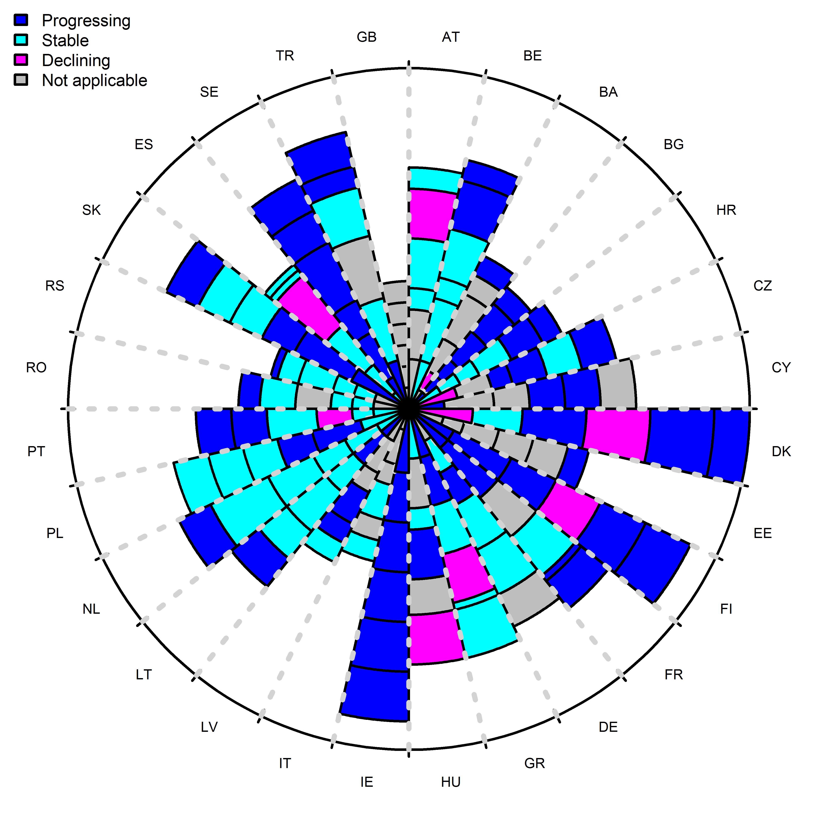
Cadre politique: tendances
Variables (ex: Danemark)
Normes et standards
Autorité de régulation
Mécanisme interministériel
Lien avec autres acteurs
Mécanisme de co-régulation
Rapports
FAIBLESSE: COORDINATION ET RAPPORTS
Notes:
“Reporting” is the weakest variable. More than two thirds (87 %) of the countries show the absence or an initial stage of reporting for public policies at national and European level. This has implications for accountability and for feedback on existing situations, and capacity to modify policy accordingly. Trends show some expected progression for a third of all countries (36%). Reporting remains however weak in the trends for this dimension.
Standard setting tools, the legitimate public policy means of agency, are moderately significant (59%) indicating diverse levels of application across Europe (Figure 10). Some countries have the full range of policy tools and other are devoid of standard setting tools (Figure 10).
A comparison of figure 10 with Figure 7 shows that standard setting tools are strongly aligned on the two oldest literacies: MIL, while they seem to be lagging behind for computing and digital literacies.
Progression in the development of standard setting tools seems to be expected in 10 out of 28 countries, some at an already advanced (France, Finland, Turkey) or initial stage (Greece). 5 countries out of 28 (21 %) assessed this unit as “not applicable” and only one (3,5%) as “declining” (Austria). Most countries, however, see their standard setting tools stabilized (10) or progressing (12)
When crossing levels with trends the data shows asymmetrical results, with several groups of countries: about a third of the countries attempting to progress, a third being stable and another third declining or not showing applicable policy framework. There seems to be very moderate opportunities for change and improvement as if reaching a peak or glass ceiling.

Slide 12
Cadre /Financement/Evaluation NIVEAUX Tendances
FAIBLESSE : UN CERCLE VICIEUX
Notes:
Public policy: not a fully driving force, caught in between the weakness of funding and evaluation
The radar picture in the left, in spite of its magnifying tendency, shows that public policy and funding are both moderately significant while evaluation is weakly significant. When crossing public policy reporting (41%), financial reporting (33%) and evaluation reporting (24%), the efforts are twice as strong in public policy reporting compared to evaluation reporting, though results remain moderately significant.
The strength of funding compared to public policy calls on the sovereignty of the state and the responsibility of public actors in MIL as it implies that funding may be coming from other sectors. This needs to be mitigated by the data showing the weakness in reporting, both in funding and in evaluation.
Poor reporting in funding and in evaluation can be accountable for more or less efficient public policies. Besides, funding, whether it be private or public, might be in competition with public policy frameworks as a driving force.
The weakness in evaluation may come from the history and nature of MIL, as a political project and a pedagogical practice that developed outside the school system. However, recent research on evaluation for project-based learning shows that assessment criteria are related to specific social skills and abilities, among which lies ME
Policy Framework strives between poor funding and even poorer evaluation, with rare exceptions (Portugal, EE), where levels are the same in the three dimensions .
3. To the extent that historically MIL evolved out of schools, the dimension “other actors” has an important role to play and can display the characteristics of governance (coordination, implementation,…).

Slide 13
Cadre/Formation/Ressources NIVEAUX TENDANCES
FAIBLESSE: EFFET DE TROMPE L’OEIL 1
Notes:
2
Effet de trompe l’oeil
Public policy: not a fully driving force, the weakness of funding and evaluation
The second hypothesis cannot be fully validated since public policy is not appearing as the strongest and leading dimension overall though it is significantly present everywhere in European countries.
The radar picture (figure 32), in spite of its magnifying tendency, shows that public policy and funding are both moderately significant while evaluation is weakly significant. When crossing public policy reporting (41%), financial reporting (33%) and evaluation reporting (24%), the efforts are twice as strong in public policy reporting compared to evaluation reporting, though results remain moderately significant.
The strength of funding compared to public policy calls on the sovereignty of the state and the responsibility of public actors in MIL as it implies that funding may be coming from other sectors. This needs to be mitigated by the data showing the weakness in reporting, both in funding and in evaluation. Poor reporting in funding and in evaluation can be accountable for more or less efficient public policies. Besides, funding, whether it be private or public, might be in competition with public policy frameworks as a driving force.
The weakness in evaluation may come from the history and nature of MIL, as a political project and a pedagogical practice that developed outside the school system. However, recent research on evaluation for project-based learning shows that assessment criteria are related to specific social skills and abilities, among which lies ME
Figure 32 shows that Policy Framework strives between poor funding and even poorer evaluation, with rare exceptions (Portugal, EE), where levels are the same in the three dimensions .
Ressources is a driving force more than the policy framework

Slide 14
Cadre/ressources/autres acteurs NIVEAUX
TENDANCES
Notes:
The second hypothesis could therefore NOT be fully validated since public policy is not appearing as the strongest and leading dimension overall though it is significantly present everywhere in European countries.
Other actors show a major and sustained involvement
Building a policy framework insuch a context seems to generate a DISCONNECT EFFECT
With respect to outstanding policies with immediate consequences in the school setting, there is like an inverted “disengagement” between an existing but weak political framework, and capacity building in partnership with the public school system fairly present and active. The stronger the policy framework (official documents, standard setting tools), the stronger the capacity building within the school system in terms of training and materials (ias in this radar chart).
However, most resources are not necessarily produced by the public sector, indicating that other sectors are coming to the rescue. Both radar charts show that the “Other actors” and “Resources” curve is increasing in size when we look at trends, while policy framework variations are much bigger and seems lagging behind. Capacity-building is therefore the driving force leading far ahead an unstable and liable policy framework. MIL was not stalling but the change is coming from below the ground.
In terms of policy-framework, this disconnect can be explained by the lack of coordination within the public sector itself. Such variables as “Inter-ministerial mechanisms”, “Co-regulatory mechanisms” and “Overlapping structures” are low in most countries. This suggests that MIL issues —horizontal in character, involving media, education, IT providers and researchers—, are still treated in a silo approach instead of being acknowledged as part of multiple ministries competence sphere. Strong coordination practices are missing, and a formal governance framework does not exist in most countries, that tend to prefer a very centralised decision-making within ministries and state agencies, not across sectors, which leads to fragmentation in the national policy frameworks of MIL. Experts in their future trends seem to indicate a decline in the involvement of “overlapping structures” and “regulatory media authorities” in MIL.
This scarcity of coordination is also evident in the lack of attention to collecting evidence about policy implementation and effectiveness as well, with a great variability from country to country. The absence of monitoring, evaluation and reporting activities is consistently verified in the data (not to mention the difficulty in collecting scarce data experienced by all experts). This leads to a “ , as scarce evaluation leads to poor funding which in turn leads to lack of investment in MIL. Conversely, more funding and more evaluation lend each other more legitimacy. This “catch-22” reinforces the fragmentation of national policies as specific budgets earmarked for MIL tend to be fused with other ministerial components that dilute them. Such a situation is clearly detrimental to MIL in terms of policy focus and development, as trends show a rise of industry actors with their self-regulatory strategies and their marketing and employment interests, compromising the citizenship dimension of MIL to other interests.

Slide 15
TENDANCES
HYPOTHESE 2:
Partiellement valide
➔Cercle vicieux
➔ Effet de trompe l’oeil (1)
Notes:
The second hypothesis could therefore NOT be fully validated since public policy is not appearing as the strongest and leading dimension overall though it is significantly present everywhere in European countries.
Other actors show a major and sustained involvement
Building a policy framework insuch a context seems to generate a DISCONNECT EFFECT
With respect to outstanding policies with immediate consequences in the school setting, there is like an inverted “disengagement” between an existing but weak political framework, and capacity building in partnership with the public school system fairly present and active. The stronger the policy framework (official documents, standard setting tools), the stronger the capacity building within the school system in terms of training and materials (ias in this radar chart).
However, most resources are not necessarily produced by the public sector, indicating that other sectors are coming to the rescue. Both radar charts show that the “Other actors” and “Resources” curve is increasing in size when we look at trends, while policy framework variations are much bigger and seems lagging behind. Capacity-building is therefore the driving force leading far ahead an unstable and liable policy framework. MIL was not stalling but the change is coming from below the ground.
In terms of policy-framework, this disconnect can be explained by the lack of coordination within the public sector itself. Such variables as “Inter-ministerial mechanisms”, “Co-regulatory mechanisms” and “Overlapping structures” are low in most countries. This suggests that MIL issues —horizontal in character, involving media, education, IT providers and researchers—, are still treated in a silo approach instead of being acknowledged as part of multiple ministries competence sphere. Strong coordination practices are missing, and a formal governance framework does not exist in most countries, that tend to prefer a very centralised decision-making within ministries and state agencies, not across sectors, which leads to fragmentation in the national policy frameworks of MIL. Experts in their future trends seem to indicate a decline in the involvement of “overlapping structures” and “regulatory media authorities” in MIL.
This scarcity of coordination is also evident in the lack of attention to collecting evidence about policy implementation and effectiveness as well, with a great variability from country to country. The absence of monitoring, evaluation and reporting activities is consistently verified in the data (not to mention the difficulty in collecting scarce data experienced by all experts). This leads to a “ , as scarce evaluation leads to poor funding which in turn leads to lack of investment in MIL. Conversely, more funding and more evaluation lend each other more legitimacy. This “catch-22” reinforces the fragmentation of national policies as specific budgets earmarked for MIL tend to be fused with other ministerial components that dilute them. Such a situation is clearly detrimental to MIL in terms of policy focus and development, as trends show a rise of industry actors with their self-regulatory strategies and their marketing and employment interests, compromising the citizenship dimension of MIL to other interests.

Slide 16
Autres acteurs/cadre NIVEAUX
TENDANCES
Important role of other actors
FAIBLESSE : EFFET DE DECALAGE/DEBRAYAGE
Notes:
HYPOTHESIS 3.
To the extent that historically MIL evolved out of schools, the dimension “other actors” has an important role to play and can display the characteristics of governance (coordination, implementation,…).
Other actors: a major and sustained involvement
Building a policy framework: the disconnect effect
With respect to outstanding policies with immediate consequences in the school setting, there is like an inverted “disengagement” between an existing but weak political framework, and capacity building in partnership with the public school system fairly present and active. The stronger the policy framework (official documents, standard setting tools), the stronger the capacity building within the school system in terms of training and materials (Figure 38).
However, most resources are not necessarily produced by the public sector, indicating that other sectors are coming to the rescue. Both radar charts (Figures 38 a-b35). show that the “Other actors” and “Resources” curve is increasing in size, while policy framework variations are much bigger and seems lagging behnd. Capacity-building is the driving force leading far ahead an unstable and liable policy framework
In terms of policy-framework, this disconnect can be explained by the lack of coordination within the public sector itself. Such variables as “Inter-ministerial mechanisms”, “Co-regulatory mechanisms” and “Overlapping structures” are low in most countries. This suggests that MIL issues —horizontal in character, involving media, education, IT providers and researchers—, are still treated in a silo approach instead of being acknowledged as part of multiple ministries competence sphere. Strong coordination practices are missing, and a formal governance framework does not exist in most countries, that tend to prefer a very centralised decision-making within ministries and state agencies, not across sectors, which leads to fragmentation in the national policy frameworks of MIL. Experts in their future trends seem to indicate a decline in the involvement of “overlapping structures” and “regulatory media authorities” in MIL.
This scarcity of coordination is also evident in the lack of attention to collecting evidence about policy implementation and effectiveness as well, with a great variability from country to country. The absence of monitoring, evaluation and reporting activities is consistently verified in the data (not to mention the difficulty in collecting scarce data experienced by all experts). This leads to a “catch-22” situation, as scarce evaluation leads to poor funding which in turn leads to lack of investment in MIL. Conversely, more funding and more evaluation lend each other more legitimacy. This “catch-22” reinforces the fragmentation of national policies as specific budgets earmarked for MIL tend to be fused with other ministerial components that dilute them. Such a situation is clearly detrimental to MIL in terms of policy focus and development, as trends show a rise of industry actors with their self-regulatory strategies and their marketing and employment interests, compromising the citizenship dimension of MIL to other interests.

Slide 17
Autres acteurs /Ressources/formation NIVEAUX
TENDANCES
FAIBLESSE: EFFET DE TROMPE L’ŒIL 2
Notes:
3. To the extent that historically MIL evolved out of schools, the dimension “other actors” has an important role to play and can display the characteristics of governance (coordination, implementation,…).
Other actors: a major and sustained involvement
4.3 Engaging stakeholders: the trompe l’oeil effect
With respect to the role of actors outside the school system, there seems to be another optical illusion, which confirms the strength of these actors coming from the informal sector outside the school system (civil society and private sector). They are, in great majority, the ones who produce and promote resources and learning initiatives that complement the public sector policies. They may have initiatives and learning events that either challenge or complement the policies of the public sector.
Other actors are a driving force

Slide 18
TENDANCES
HYPOTHESE 2:
Partiellement invalidée
➔Effet de décalage/débrayage
➔ Effet de trompe l’oeil (2)
Notes:
The second hypothesis could therefore NOT be fully validated since public policy is not appearing as the strongest and leading dimension overall though it is significantly present everywhere in European countries.
Other actors show a major and sustained involvement
Building a policy framework insuch a context seems to generate a DISCONNECT EFFECT
With respect to outstanding policies with immediate consequences in the school setting, there is like an inverted “disengagement” between an existing but weak political framework, and capacity building in partnership with the public school system fairly present and active. The stronger the policy framework (official documents, standard setting tools), the stronger the capacity building within the school system in terms of training and materials (ias in this radar chart).
However, most resources are not necessarily produced by the public sector, indicating that other sectors are coming to the rescue. Both radar charts show that the “Other actors” and “Resources” curve is increasing in size when we look at trends, while policy framework variations are much bigger and seems lagging behind. Capacity-building is therefore the driving force leading far ahead an unstable and liable policy framework. MIL was not stalling but the change is coming from below the ground.
In terms of policy-framework, this disconnect can be explained by the lack of coordination within the public sector itself. Such variables as “Inter-ministerial mechanisms”, “Co-regulatory mechanisms” and “Overlapping structures” are low in most countries. This suggests that MIL issues —horizontal in character, involving media, education, IT providers and researchers—, are still treated in a silo approach instead of being acknowledged as part of multiple ministries competence sphere. Strong coordination practices are missing, and a formal governance framework does not exist in most countries, that tend to prefer a very centralised decision-making within ministries and state agencies, not across sectors, which leads to fragmentation in the national policy frameworks of MIL. Experts in their future trends seem to indicate a decline in the involvement of “overlapping structures” and “regulatory media authorities” in MIL.
This scarcity of coordination is also evident in the lack of attention to collecting evidence about policy implementation and effectiveness as well, with a great variability from country to country. The absence of monitoring, evaluation and reporting activities is consistently verified in the data (not to mention the difficulty in collecting scarce data experienced by all experts). This leads to a “ , as scarce evaluation leads to poor funding which in turn leads to lack of investment in MIL. Conversely, more funding and more evaluation lend each other more legitimacy. This “catch-22” reinforces the fragmentation of national policies as specific budgets earmarked for MIL tend to be fused with other ministerial components that dilute them. Such a situation is clearly detrimental to MIL in terms of policy focus and development, as trends show a rise of industry actors with their self-regulatory strategies and their marketing and employment interests, compromising the citizenship dimension of MIL to other interests.

Slide 19
A
SWOT
CAPACITY BUILDING
FORCES
OPPORTUNITES
FORMATION
RESSOURCES
AUTRES ACTEURS
DEFINITION ++
CADRE POLITIQUE ++
MULTIMODALITE
TRANSLITTERATIE
FAIBLESSES
RISQUES
REPORTING
DEFINITION –
CADRE POLITIQUE –
FINANCEMENT
EVALUATION
LAME DE FOND NUMÉRIQUE
EFFET DE TROMPE L’ŒIL (1 & 2)
CERCLE VICIEUX
EFFET DE DECALAGE
Notes:
To summarize
Capacity Building embraces the strongest dimensions of public policies
Funding and evaluation being the weakes onesin their catch 22 legitimation process
Definition affects policy framework, and policy framework got hit by th edigital undertow with

Slide 20
CADRE POLITIQUE
SECTEUR PRIVE
SECTEUR PUBLIC
RESSOURCES
MULTIMODALITE/TRANSLITERATIE
SECTEUR CIVIQUE
EVALUATION
FORMATION
FINANCEMENT
Pyramide EMI
STANDARDS
VALEURS ET DROITS
EVALUATION
AUTRES ACTEURS
CONTRÔLE QUALITE
MODALITES
MOYENS
Notes:
We modelized a 3.0. MIL pyramid
The summet is represented by the legal framework pulled up by th epublic sector
Allowing for a more coordinated work among stakeholders
Across th epyramid all of the stakeholders from the three sectors
At the base, the four pilars of means and modalities to implement MIL: The strongest and darkest to our left, and the lightest and currently weakest dimensions to our right that should sustain a solid governance moderl provided that pedagogically we induce multimodal and transliterate approaches, allowing for the complexity of MIL’s definition to be significant.
Ths architexture/architecture edifying MIL shows that legal framework faces ethic and values with standards, while ressoures and training show ppor quality control and poor evaluation.
QUALITY CONTROL joindre les process et les résultats
OUTCOME = produit > conséquence, aboutissement et incidénce / parcours = DELIVRABLES
OUTPUT = produit > productivité, volume, rendement / résultat = LVIRABLES

Slide 21
MODÉLISATION gouvernance de l’EMI
Modèle des 3D de la gouvernance de l’EMI
Développement
Délégation
Désengagement
Risque: Dysfonctionnement
Notes:
From the MIL 3.0 pyramid and the global results by country, we are proposing a 3D governance model in MIL PUBLIC POLICY which could look like this

Slide 22
Retrouvez nous le 7-8 novembre
Cité des sciences
« les littératies du XXIe siècle sens dessus dessous: périmètres, interactions, territoires »
^{Contact}
Divina Frau-Meigs – U Sorbonne Nouvelle
divina.frau-meigs@univ-paris3.fr

